Slide 1

Course : Data Structures
Subject Code : CSEN2001 Program : B. Tech
Year : II
Dept. and Sec : CSE ( )
UNIT : II
Dr Kranthi Kumar Singamaneni
Dept. of C.S.E
G.S.T, GITAM Deemed to be University

Slide 2

UNIT - II Linked list
Linked lists:
Creation of
Single linked list,
Double linked list,
Circular linked list,
Operations on them.

Slide 3

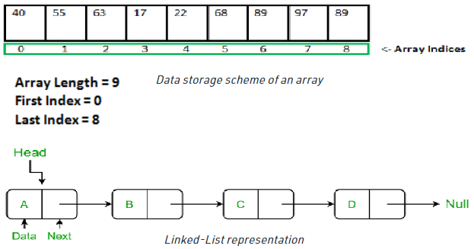
Array vs Linked List
Array: Arrays store elements in contiguous memory locations, resulting in easily calculable addresses for the elements stored and this allows faster access to an element at a specific index.
Linked List: Linked lists are less rigid in their storage structure and elements are usually not stored in contiguous locations; hence they need to be stored with additional tags giving a reference to the next element.
This difference in the data storage scheme decides which data structure would be more suitable for a given situation.

Slide 4
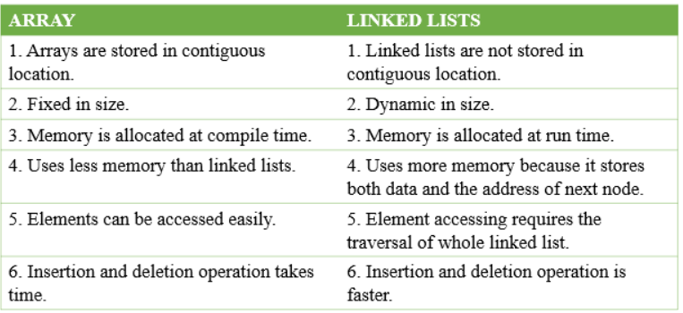


A linked list is a linear data structure, in which the elements are not stored at contiguous memory locations. The elements in a linked list are linked using pointers as shown in the above image:
In simple words, a linked list consists of nodes where each node contains a data field and a reference(link) to the next node in the list.

Slide 5



Slide 6



Slide 7
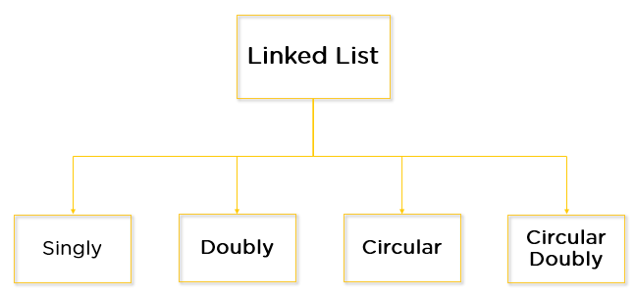

What Are the Types of Linked Lists?
Creation and Traversal of Singly Linked List
A linked list is a data structure that stores a sequence of elements. Each element in the list is called a node, and each node has a reference to the next node in the list. The first node in the list is called the head, and the last node in the list is called the tail.
To create a singly linked list, we first need to create a node class. Each node will have two data members: an integer value and a reference to the next node in the list. Next, we need to create a LinkedList class. This class will have two data members: a head node and a tail node. The head node will store the first element in the list, and the tail node will store the last element in the list.
To add an element to the list, we need to create a new node and set the next reference of the previous tail node to point to the new node. Then, we can set the new node as the new tail of the list.
To remove an element from the list, we need to find the node that contains the value that we want to remove. We can do this by traversing the list until we find the node with the matching value. Once we find the node, we need to set the next reference of the previous node to point to the next node. To search for an element in the list, we need to traverse the list until we find the node with the matching value. To traverse the list, we can start at the head node and follow the next references until we reach the tail node.
What is a Singly Linked List (SLL)?
A SLL is a unidirectional linked list. So, you can only traverse it in one direction, i.e., from the head node to the tail node.
Structure of Singly Linked List: There are many applications for singly-linked lists. One common application is to store a list of items that need to be processed in the order.
For example, a singly linked list can be used to store a list of tasks that need to be completed, with the head node representing the first task to be completed and the tail node representing the last task to be completed.
Singly-linked lists are also often used in algorithms that need to process a list of items in reverse order. For example, the popular sorting algorithm quicksort uses a singly linked list to store the list of items that need to be sorted. By processing the list in reverse order, quicksort can sort the list more efficiently.

Slide 8

What is a Double Linked List (DLL)?
Creation and Traversal of DLL: A DLL is a type of data structure that allows for the storage of data in a linear fashion, much like a singly linked list. However, unlike a singly linked list, a DLL allows for both forward and backward traversal of the data stored within it. This makes it an ideal data structure for applications that require the ability to move both forward and backward through a list of data.
To create a DLL, we first need to create a Node class that will be used to store our data. This Node class will have two attributes: data and next. The data attribute will be used to store the actual data that we want to store in our list, and the next attribute will be used to store a reference to the next node in the list.
Once we have our Node class, we can create our DLL. To do this, we need to create a class that will represent our list. This class will have two attributes: head and tail. The head attribute will be used to store a reference to the first node in our list, and the tail attribute will be used to store a reference to the last node in our list.
After the list class is created, we can begin adding data to it. To add data to our list, we need to create a new node and set its data attribute to the data that we want to add. Then, we need to set the next attribute of the new node to point to the head node of our list. Finally, we need to set the head node of our list to point to the new node.
Now that we know how to add data to our list, we can write a function to traverse our list. To do this, we need to create a variable that will keep track of the current node that we are traversing. We can set this variable to the head node of our list to start. Then, we need to create a while loop that will continue until the current node is None, which indicates that we have reached the end of our list.
Within our while loop, we need to print out the data that is stored in the current node. Then, we need to set the current node to the next node in our list before continuing to the next iteration of the loop.
A is a bi-directional linked list. So, you can traverse it in both directions. Unlike singly linked lists, its nodes contain one extra pointer called the previous pointer This pointer points to the previous node.
Structure of DLL: A DLL of singly linked lists is a data structure that consists of a set of singly linked lists (SLLs), each of which is doubly linked. It is used to store data in a way that allows for fast insertion and deletion of elements.
Each SLL is made up of two parts: a head and a tail. The head of each SLL contains a pointer to the first element in the list, and the tail contains a pointer to the last element.
It is advantageous over other data structures because it allows for quick insertion and deletion of elements. Additionally, it is easy to implement and can be used in a variety of applications.

Slide 9
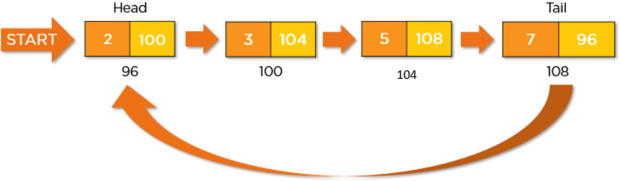
What is a CLL(CLL)?
Accessing data in a CLL is similar to accessing data in a traditional linked list. However, because there is no defined beginning or end to the list, it can be difficult to know where to start traversing the list. As a result, many implementations of CLLs use a "head" pointer that points to the first node in the list.
CLLs have a number of advantages over traditionally linked lists. First, because there is no defined beginning or end to the list, data can be added and removed from the list at any time. This makes CLLs ideal for applications where data needs to be constantly added or removed, such as in a real-time application.
Second, because data is stored in a ring-like structure, it can be accessed in a continuous loop. This makes CLLs ideal for applications where data needs to be processed in a continuous loop, such as in a real-time application or simulation.
Third, because there is no defined beginning or end to the list, CLLs are typically more efficient than traditional linked lists when it comes to memory usage. This is because traditionally linked lists often require additional memory for pointers that point to the beginning and end of the list. CLLs, on the other hand, only require a single pointer to be stored in memory – the head pointer.
Finally, CLLs are often easier to implement than traditional linked lists. This is because traditional linked lists often require the use of additional data structures, such as stacks and queues, to keep track of the list's beginning and end. CLLs, on the other hand, only require a singly linked list data structure.
A CLL is a unidirectional linked list. So, you can traverse it in only one direction. But this type of linked list has its last node pointing to the head node. So while traversing, you need to be careful and stop traversing when you revisit the head node.
Structure of CLL: A CLL is a type of data structure that uses linked list technology to store data in a linear, sequential fashion. However, unlike a traditional linked list, a CLL has no beginning or end – it is essentially a ring of nodes. This makes CLLs ideal for applications where data needs to be processed in a continuous loop, such as in real-time applications or simulations.
CLLs are typically implemented using a singly linked list data structure. This means that each node in the list is connected to the next node via a pointer. The last node in the list is then connected back to the first node, creating the ring-like structure.

Slide 10
What is a CLL(CLL)? (Cont.)
Creation and Traversal of CLL:
A CLL is a type of data structure that can store a collection of items. It is related to both the singly linked list and the doubly linked list. Unlike a singly linked list, which has a NULL pointer at the end of the list, a CLL has a pointer that points back to the first node in the list. This makes it possible to traverse the entire list without having to keep track of the end of the list.
There are two types of CLLs: singly linked and doubly linked. In a singly linked circular linked list, each node has a pointer that points to the next node in the list. The last node in the list points back to the first node. In a doubly linked circular linked list, each node has pointers that point to both the next node and the previous node.
CLLs have many applications. They can be used to implement queues, stacks, or deques. They can also be used for applications that require circular buffers or circular arrays.
There are two ways to create a circular linked list:
Create a singly linked list and make the last node point to the first node.
Create a doubly linked list and make the last node point to the first node and the first node point to the last node.
To create a singly linked circular linked list, we first need to create a singly linked list. We can do this by creating a Node class and a LinkedList class. The Node class will represent each node in the list, and the LinkedList class will represent the list itself.
To create a doubly linked circular linked list, we first need to create a doubly linked list. We can do this by creating a Node class and a LinkedList class. The Node class will represent each node in the list, and the LinkedList class will represent the list itself.
Once we have created our Node and LinkedList classes, we can create a CLL by creating a few nodes and linking them together. To do this, we first need to create a few nodes. Then, we need to link the nodes together to form a circular linked list. We can also link the nodes together in a doubly linked list.
There are two ways to traverse a circular linked list:
Traverse the list until you reach the head node again.
Keep track of the nodes you have visited.
To traverse the list until you reach the head node again, you can use a while loop. If you want to keep track of the nodes you have visited, you can use a list or set.

Slide 11
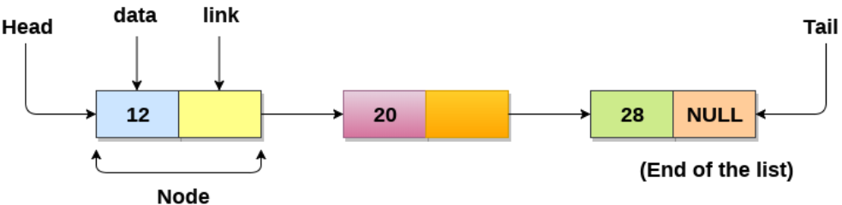
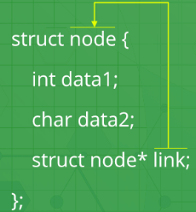
Basic Operations on Linked List: There are various linked list operations that allow us to perform different actions on linked lists. Here's a list of basic linked list operations that we will cover in this session.
createList(): To create the list with ‘n’ number of nodes initially as defined by the user.
traverse(): To see the contents of the linked list, it is necessary to traverse the given linked list. The given traverse() function traverses and prints the content of the linked list.
insertAtFront(): This function simply inserts an element at the front/beginning of the linked list.
insertAtEnd(): This function inserts an element at the end of the linked list.
insertAtPosition(): This function inserts an element at a specified position in the linked list.
deleteFirst(): This function simply deletes an element from the front/beginning of the linked list.
deleteEnd(): This function simply deletes an element from the end of the linked list.
deletePosition(): This function deletes an element from a specified position in the linked list.
maximum(): This function finds the maximum element in a linked list.
mean(): This function finds the mean of the elements in a linked list.
sort(): This function sort the given linked list in ascending order.
reverseLL(): This function reverses the given linked list.
Before you learn about linked list operations in detail, make sure to know about linked list first.
Things to Remember about Linked List:
The head points to the first node of the linked list
The next pointer of the last node is NULL, so if the next current node is NULL, we have reached the end of the linked list.
Self Referential structures are those structures that have one or more pointers that point to the same type of structure, as their member.
In other words, structures pointing to the same type of structures are self-referential in nature

Slide 12
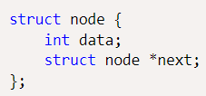
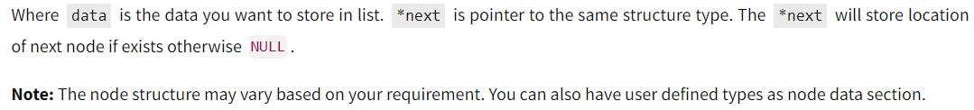
How to create a linked list?

Slide 13
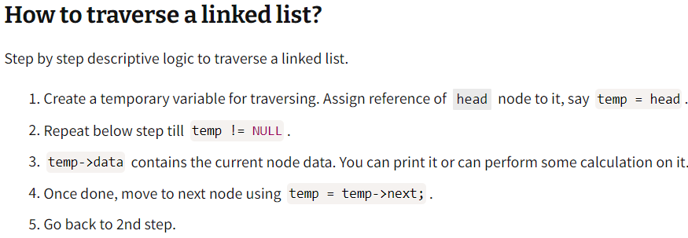
How to create a linked list?

Slide 14
Example Program to create and traverse a linked list?
struct node//Structure of a node
{
int data;//Data
struct node *next;//Address
}*head;
int main()
{
int n;
printf("Enter the total number of nodes: ");
scanf("%d", &n);
createList(n);
printf("\nData in the list \n");
traverseList();
return 0;
}
void createList(int n)//Create a list of n nodes
{
struct node *newNode, *temp; int data, i;
head = (struct node *)malloc(sizeof(struct node));
if(head == NULL)//Terminate if memory not allocated
{
printf("Unable to allocate memory.");
exit(0);
}
printf("Enter the data of node 1: ");
scanf("%d", &data);
head->data = data;//Link data field with data
head->next = NULL;// Link address field to NULL
// Create n - 1 nodes and add to list
temp = head;
for(i=2; i<=n; i++)
{
newNode = (struct node *)malloc(sizeof(struct node));
if(newNode == NULL)//If memory is not allocated for newNode
{
printf("Unable to allocate memory.");
break;
}
printf("Enter the data of node %d: ", i);
scanf("%d", &data);
newNode->data = data; // Link data field of newNode
newNode->next = NULL; // Make sure new node points to NULL
temp->next = newNode; // Link previous node with newNode
temp = temp->next; // Make current node as previous node
}
}

Slide 15
Example Program to create and traverse a linked list?
void traverseList()
{
struct node *temp;
if(head == NULL) // Return if list is empty
{
printf("List is empty.");
return;
}
temp = head;
while(temp != NULL)
{
printf("Data = %d\n", temp->data);
// Print data of current node
temp = temp->next;
// Move to next node
}
}

Slide 16
// C program for the all operations in the SLL
#include <stdio.h>
#include <stdlib.h>
struct node // Linked List Node
{
int info;
struct node* link;
};
struct node* start = NULL;
void createList() //create list with n nodes initially
{
if (start == NULL)
{
int n;
printf("\nEnter the number of nodes: ");
scanf("%d", &n);
if (n != 0)
{
int data;
struct node* newnode;
struct node* temp;
newnode = malloc(sizeof(struct node));
start = newnode;
temp = start;
printf("\nEnter number to be inserted : ");
scanf("%d", &data);
start->info = data;
for (int i = 2; i <= n; i++)
{
newnode = malloc(sizeof(struct node));
temp->link = newnode;
printf("\nEnter number to be inserted : ");
scanf("%d", &data);
newnode->info = data;
temp = temp->link;
}
}
printf("\nThe list is created\n");
}
else
printf("\nThe list is already created\n");
}
void traverse() //Traverse the linked list
{
struct node* temp;
if (start == NULL) // List is empty
printf("\nList is empty\n");
else// Else print the LL
{
temp = start;
while (temp != NULL) {
printf("Data = %d\n", temp->info);
temp = temp->link;
}
}
}
void insertAtFront() // Insert at the front of the linked list
{
int data;
struct node* temp;
temp = malloc(sizeof(struct node));
printf("\nEnter number to be inserted : ");
scanf("%d", &data);
temp->info = data;
temp->link = start; // Pointer of temp will be assigned to start
start = temp;
}
void insertAtEnd() // Function to insert at the end of the linked list
{
int data;
struct node *temp, *head;
temp = malloc(sizeof(struct node));
printf("\nEnter number to be inserted : "); // Enter the number
scanf("%d", &data);
// Changes links
temp->link = 0;
temp->info = data;
head = start;
while (head->link != NULL)
{
head = head->link;
}
head->link = temp;
}

Slide 17
void insertAtPosition()
{
struct node *temp, *newnode;
int pos, data, i = 1;
newnode = malloc(sizeof(struct node));
printf("\nEnter position and data :");
scanf("%d %d", &pos, &data);
// Change Links
temp = start;
newnode->info = data;
newnode->link = 0;
while (i < pos - 1)
{
temp = temp->link;
i++;
}
newnode->link = temp->link;
temp->link = newnode;
}
void deleteFirst()
{
struct node* temp;
if (start == NULL)
printf("\nList is empty\n");
else
{
temp = start;
start = start->link;
free(temp);
}
}
void deleteEnd()
{
struct node *temp, *prevnode;
if (start == NULL) printf("\nList is Empty\n");
else
{
temp = start;
while (temp->link != 0)
{
prevnode = temp; temp = temp->link;
}
free(temp);
prevnode->link = 0;
}
}
void deletePosition()
{
struct node *temp, *position; int i = 1, pos;
if (start == NULL) // If LL is empty
printf("\nList is empty\n");
else // Otherwise
{
printf("\nEnter index : ");
scanf("%d", &pos); // Position to be deleted
position = malloc(sizeof(struct node)); temp = start;
while (i < pos - 1) // Traverse till position
{
temp = temp->link; i++;
}
// Change Links
position = temp->link;
temp->link = position->link;
free(position); // Free memory
}
}
void maximum()
{
int a[10]; int i; struct node* temp;
if (start == NULL) // If LL is empty
printf("\nList is empty\n");
else // Otherwise
{
temp = start; int max = temp->info;
while (temp != NULL) // Traverse LL and update the maximum element
{
if (max < temp->info) // Update the maximum element
max = temp->info; temp = temp->link;
}
printf("\nMaximum number is : %d ",max);
}
}
void mean() // Function to find the mean of the elements in the linked list
{
int a[10]; int i; struct node* temp;
if (start == NULL) // If LL is empty
printf("\nList is empty\n");
else // Otherwise
{
temp = start;
// Stores the sum and count of element in the LL
int sum = 0, count = 0; loat m;
while (temp != NULL) // Traverse the LL
{
sum = sum + temp->info; // Update the sum
temp = temp->link; count++;
}
m = sum / count; // Find the mean
printf("\nMean is %f ", m); // Print the mean value
}
}

Slide 18
void sort()
{
struct node* current = start; struct node* index = NULL; int temp;
if (start == NULL) // If LL is empty
{ return; }
else //Else
{
while (current != NULL) // Traverse the LL
{
index = current->link;
while (index != NULL) // Traverse the LL nested Ly and find the minimum element
{
if (current->info > index->info) // Swap with it the value at current
{
temp = current->info; current->info = index->info; index->info = temp;
}
index = index->link;
}
current = current->link; // Update the current
}}}
void reverseLL() // Function to reverse the linked list
{
struct node *t1, *t2, *temp; t1 = t2 = NULL;
if (start == NULL) // If LL is empty
printf("List is empty\n");
else // Else
{
while (start != NULL) // Traverse the LL
{
t2 = start->link; // reversing of points start->link = t1; t1 = start; start = t2;
}
start = t1; temp = start; // New head Node
printf("Reversed linked list is : ");
while (temp != NULL) // Print the LL
{
printf("%d ", temp->info); temp = temp->link;
}}}
int main() // Driver Code
{ int choice;
while (1)
{
printf("\n\t1 To see list\n");
printf("\t2 For insertion at starting\n");
printf("\t3 For insertion at end\n");
printf("\t4 For insertion at any position\n");
printf("\t5 For deletion of first element\n");
printf("\t6 For deletion of last element\n");
printf("\t7 For deletion of element at any position\n");
printf("\t8 To find maximum among the elements\n");
printf("\t9 To find mean of the elements\n");
printf("\t10 To sort element\n");
printf("\t11 To reverse the linked list\n");
printf("\t12 To exit\n");
printf("\nEnter Choice :\n");
scanf("%d", &choice);
switch (choice)
{
case 1: traverse(); break; case 2: insertAtFront(); break;
case 3: insertAtEnd(); break; case 4: insertAtPosition(); break;
case 5: deleteFirst(); break; case 6: deleteEnd(); break;
case 7: deletePosition(); break;
case 8: maximum(); break;
case 9: mean(); break;
case 10: sort(); break;
case 11: reverseLL(); break;
case 12: exit(1); break;
default: printf("Incorrect Choice\n");
}}
return 0;
}

Slide 19
int main()
{
int choice;
clrscr();
while (1)
{
printf("\n\t1 To see list\n");
printf("\t2 For insertion at starting\n");
printf("\t3 For insertion at end\n");
printf("\t4 For insertion at any position\n");
printf("\t5 For deletion of first element\n");
printf("\t6 For deletion of last element\n");
printf("\t7 For deletion of element at any position\n");
printf("\t8 To find maximum among the elements\n");
printf("\t9 To find mean of the elements\n");
printf("\t10 To sort element\n");
printf("\t11 To reverse the linked list\n");
printf("\t12 To exit\n");
printf("\nEnter Choice :\n");
scanf("%d", &choice);
switch (choice)
{
case 1: traverse(); break;
case 2: insertAtFront(); break;
case 3: insertAtEnd(); break;
case 4: insertAtPosition(); break;
case 5: deleteFirst(); break;
case 6: deleteEnd(); break;
case 7: deletePosition(); break;
case 8: maximum(); break;
case 9: mean(); break;
case 10: sort(); break;
case 11: reverseLL(); break;
case 12: exit(1); break;
default: printf("Incorrect Choice\n");
}
}
getch();
return 0;
}

Slide 20
// Linked List Node
struct node
{
int info;
struct node* link;
};
struct node* start = NULL;
void createList() // Function to create list with n nodes initially
{
if (start == NULL)
{
int n,i;
printf("\nEnter the number of nodes: ");
scanf("%d", &n);
if (n != 0)
{
int data;
struct node* newnode;
struct node* temp;
newnode = malloc(sizeof(struct node));
start = newnode;
temp = start;
printf("\nEnter number to be inserted : ");
scanf("%d", &data);
start->info = data;
for (i = 2; i <= n; i++)
{
newnode = malloc(sizeof(struct node));
temp->link = newnode;
printf("\nEnter number to be inserted : ");
scanf("%d", &data);
newnode->info = data;
temp = temp->link;
}
}
printf("\nThe list is created\n");
}
else
printf("\nThe list is already created\n");
}

Slide 21
void traverse() // Function to traverse the linked list
{
struct node* temp;
if (start == NULL) // List is empty
printf("\n List is empty\n");
else // Else print the LL
{
temp = start;
while (temp != NULL)
{
printf("Data = %d\n", temp->info);
temp = temp->link;
}
}
}
void insertAtFront() // Function to insert at the front of the linked list
{
int data;
struct node* temp;
temp = malloc(sizeof(struct node));
printf("\nEnter number to be inserted:");
scanf("%d", &data);
temp->info = data;
// Pointer of temp will be assigned to start
temp->link = start;
start = temp;
}

Slide 22
// Function to insert at the end of the linked list
void insertAtEnd()
{
int data;
struct node *temp, *head;
temp = malloc(sizeof(struct node));
printf("\nEnter number to be inserted : ");
scanf("%d", &data);
// Changes links
temp->link = 0;
temp->info = data;
head = start;
while (head->link != NULL)
{
head = head->link;
}
head->link = temp;
}
// Function to insert at any specified position in the linked list
void insertAtPosition()
{
struct node *temp, *newnode;
int pos, data, i = 1;
newnode = malloc(sizeof(struct node));
// Enter the position and data
printf("\nEnter position and data :");
scanf("%d %d", &pos, &data);
// Change Links
temp = start;
newnode->info = data;
newnode->link = 0;
while (i < pos - 1)
{
temp = temp->link;
i++;
}
newnode->link = temp->link;
temp->link = newnode;
}

Slide 23
// Function to delete from the front of the linked list
void deleteFirst()
{
struct node* temp;
if (start == NULL)
printf("\nList is empty\n");
else {
temp = start;
start = start->link;
free(temp);
}
}
// Function to delete from the end of the linked list
void deleteEnd()
{
struct node *temp, *prevnode;
if (start == NULL)
printf("\nList is Empty\n");
else {
temp = start;
while (temp->link != 0)
{
prevnode = temp;
temp = temp->link;
}
free(temp);
prevnode->link = 0;
}
}

Slide 24
void deletePosition()
{
struct node *temp, *position; int i = 1, pos;
if (start == NULL)
printf("\nList is empty\n");
else
{
printf("\nEnter index : ");
scanf("%d", &pos); // Position to be deleted
position = malloc(sizeof(struct node));
temp = start;
// Traverse till position
while (i < pos - 1)
{
temp = temp->link;
i++;
}
position = temp->link; // Change Links
temp->link = position->link;
free(position); // Free memory
}
}
void maximum()
{
int a[10],max, i; struct node* temp;
if (start == NULL)
printf("\nList is empty\n");
else
{
temp = start;
max = temp->info;
// Traverse LL and update the maximum element
while (temp != NULL)
{
// Update the maximum element
if (max < temp->info)
max = temp->info;
temp = temp->link;
}
printf("\nMaximum number is : %d ",max);
}
}

Slide 25
void mean()
{
int a[10], i, sum, count; float m;
struct node* temp;
if (start == NULL)
printf("\nList is empty\n");
else
{
temp = start; sum = 0, count = 0;
while (temp != NULL)
{
sum = sum + temp->info;
temp = temp->link;
count++;
}
m = sum / count;
printf("\nMean is %f ", m);
}
}
void sort()
{
struct node* current = start; struct node* index = NULL; int temp;
if (start == NULL)
{
return;
}
else
{
while (current != NULL)
{
index = current->link;
while (index != NULL)
{
if (current->info > index->info)
{
temp = current->info; current->info = index->info; index->info = temp;
}
index = index->link;
}
current = current->link;
}
}
}

Slide 26
void reverseLL()
{
struct node *t1, *t2, *temp;
t1 = t2 = NULL;
if (start == NULL)
printf("List is empty\n");
else
{
while (start != NULL)
{
t2 = start->link; start->link = t1; t1 = start; start = t2;
}
start = t1; // New head Node
temp = start;
printf("Reversed linked list is : "); // Print the LL
while (temp != NULL)
{
printf("%d ", temp->info);
temp = temp->link;
}
}
}

Slide 27
Course : Data Structures
Subject Code : CSEN2001 Program : B. Tech
Year : II
Dept. and Sec : CSE ( )
UNIT : II
Dr Kranthi Kumar Singamaneni
Dept. of C.S.E
G.S.T, GITAM Deemed to be University

Slide 28
UNIT - II Linked list
Linked lists:
Creation of
Single linked list,
Double linked list,
Circular linked list,
Operations on them.

Slide 29
Array vs Linked List
Array: Arrays store elements in contiguous memory locations, resulting in easily calculable addresses for the elements stored and this allows faster access to an element at a specific index.
Linked List: Linked lists are less rigid in their storage structure and elements are usually not stored in contiguous locations; hence they need to be stored with additional tags giving a reference to the next element.
This difference in the data storage scheme decides which data structure would be more suitable for a given situation.

Slide 30
A linked list is a linear data structure, in which the elements are not stored at contiguous memory locations. The elements in a linked list are linked using pointers as shown in the above image:
In simple words, a linked list consists of nodes where each node contains a data field and a reference(link) to the next node in the list.

Slide 33
What Are the Types of Linked Lists?
Creation and Traversal of Singly Linked List
A linked list is a data structure that stores a sequence of elements. Each element in the list is called a node, and each node has a reference to the next node in the list. The first node in the list is called the head, and the last node in the list is called the tail.
To create a singly linked list, we first need to create a node class. Each node will have two data members: an integer value and a reference to the next node in the list. Next, we need to create a LinkedList class. This class will have two data members: a head node and a tail node. The head node will store the first element in the list, and the tail node will store the last element in the list.
To add an element to the list, we need to create a new node and set the next reference of the previous tail node to point to the new node. Then, we can set the new node as the new tail of the list.
To remove an element from the list, we need to find the node that contains the value that we want to remove. We can do this by traversing the list until we find the node with the matching value. Once we find the node, we need to set the next reference of the previous node to point to the next node. To search for an element in the list, we need to traverse the list until we find the node with the matching value. To traverse the list, we can start at the head node and follow the next references until we reach the tail node.
What is a Singly Linked List (SLL)?
A SLL is a unidirectional linked list. So, you can only traverse it in one direction, i.e., from the head node to the tail node.
Structure of Singly Linked List: There are many applications for singly-linked lists. One common application is to store a list of items that need to be processed in the order.
For example, a singly linked list can be used to store a list of tasks that need to be completed, with the head node representing the first task to be completed and the tail node representing the last task to be completed.
Singly-linked lists are also often used in algorithms that need to process a list of items in reverse order. For example, the popular sorting algorithm quicksort uses a singly linked list to store the list of items that need to be sorted. By processing the list in reverse order, quicksort can sort the list more efficiently.

Slide 34
What is a Double Linked List (DLL)?
Creation and Traversal of DLL: A DLL is a type of data structure that allows for the storage of data in a linear fashion, much like a singly linked list. However, unlike a singly linked list, a DLL allows for both forward and backward traversal of the data stored within it. This makes it an ideal data structure for applications that require the ability to move both forward and backward through a list of data.
To create a DLL, we first need to create a Node class that will be used to store our data. This Node class will have two attributes: data and next. The data attribute will be used to store the actual data that we want to store in our list, and the next attribute will be used to store a reference to the next node in the list.
Once we have our Node class, we can create our DLL. To do this, we need to create a class that will represent our list. This class will have two attributes: head and tail. The head attribute will be used to store a reference to the first node in our list, and the tail attribute will be used to store a reference to the last node in our list.
After the list class is created, we can begin adding data to it. To add data to our list, we need to create a new node and set its data attribute to the data that we want to add. Then, we need to set the next attribute of the new node to point to the head node of our list. Finally, we need to set the head node of our list to point to the new node.
Now that we know how to add data to our list, we can write a function to traverse our list. To do this, we need to create a variable that will keep track of the current node that we are traversing. We can set this variable to the head node of our list to start. Then, we need to create a while loop that will continue until the current node is None, which indicates that we have reached the end of our list.
Within our while loop, we need to print out the data that is stored in the current node. Then, we need to set the current node to the next node in our list before continuing to the next iteration of the loop.
A is a bi-directional linked list. So, you can traverse it in both directions. Unlike singly linked lists, its nodes contain one extra pointer called the previous pointer This pointer points to the previous node.
Structure of DLL: A DLL of singly linked lists is a data structure that consists of a set of singly linked lists (SLLs), each of which is doubly linked. It is used to store data in a way that allows for fast insertion and deletion of elements.
Each SLL is made up of two parts: a head and a tail. The head of each SLL contains a pointer to the first element in the list, and the tail contains a pointer to the last element.
It is advantageous over other data structures because it allows for quick insertion and deletion of elements. Additionally, it is easy to implement and can be used in a variety of applications.

Slide 35
What is a CLL(CLL)?
Accessing data in a CLL is similar to accessing data in a traditional linked list. However, because there is no defined beginning or end to the list, it can be difficult to know where to start traversing the list. As a result, many implementations of CLLs use a "head" pointer that points to the first node in the list.
CLLs have a number of advantages over traditionally linked lists. First, because there is no defined beginning or end to the list, data can be added and removed from the list at any time. This makes CLLs ideal for applications where data needs to be constantly added or removed, such as in a real-time application.
Second, because data is stored in a ring-like structure, it can be accessed in a continuous loop. This makes CLLs ideal for applications where data needs to be processed in a continuous loop, such as in a real-time application or simulation.
Third, because there is no defined beginning or end to the list, CLLs are typically more efficient than traditional linked lists when it comes to memory usage. This is because traditionally linked lists often require additional memory for pointers that point to the beginning and end of the list. CLLs, on the other hand, only require a single pointer to be stored in memory – the head pointer.
Finally, CLLs are often easier to implement than traditional linked lists. This is because traditional linked lists often require the use of additional data structures, such as stacks and queues, to keep track of the list's beginning and end. CLLs, on the other hand, only require a singly linked list data structure.
A CLL is a unidirectional linked list. So, you can traverse it in only one direction. But this type of linked list has its last node pointing to the head node. So while traversing, you need to be careful and stop traversing when you revisit the head node.
Structure of CLL: A CLL is a type of data structure that uses linked list technology to store data in a linear, sequential fashion. However, unlike a traditional linked list, a CLL has no beginning or end – it is essentially a ring of nodes. This makes CLLs ideal for applications where data needs to be processed in a continuous loop, such as in real-time applications or simulations.
CLLs are typically implemented using a singly linked list data structure. This means that each node in the list is connected to the next node via a pointer. The last node in the list is then connected back to the first node, creating the ring-like structure.

Slide 36
What is a CLL(CLL)? (Cont.)
Creation and Traversal of CLL:
A CLL is a type of data structure that can store a collection of items. It is related to both the singly linked list and the doubly linked list. Unlike a singly linked list, which has a NULL pointer at the end of the list, a CLL has a pointer that points back to the first node in the list. This makes it possible to traverse the entire list without having to keep track of the end of the list.
There are two types of CLLs: singly linked and doubly linked. In a singly linked circular linked list, each node has a pointer that points to the next node in the list. The last node in the list points back to the first node. In a doubly linked circular linked list, each node has pointers that point to both the next node and the previous node.
CLLs have many applications. They can be used to implement queues, stacks, or deques. They can also be used for applications that require circular buffers or circular arrays.
There are two ways to create a circular linked list:
Create a singly linked list and make the last node point to the first node.
Create a doubly linked list and make the last node point to the first node and the first node point to the last node.
To create a singly linked circular linked list, we first need to create a singly linked list. We can do this by creating a Node class and a LinkedList class. The Node class will represent each node in the list, and the LinkedList class will represent the list itself.
To create a doubly linked circular linked list, we first need to create a doubly linked list. We can do this by creating a Node class and a LinkedList class. The Node class will represent each node in the list, and the LinkedList class will represent the list itself.
Once we have created our Node and LinkedList classes, we can create a CLL by creating a few nodes and linking them together. To do this, we first need to create a few nodes. Then, we need to link the nodes together to form a circular linked list. We can also link the nodes together in a doubly linked list.
There are two ways to traverse a circular linked list:
Traverse the list until you reach the head node again.
Keep track of the nodes you have visited.
To traverse the list until you reach the head node again, you can use a while loop. If you want to keep track of the nodes you have visited, you can use a list or set.

Slide 37
Basic Operations on Linked List: There are various linked list operations that allow us to perform different actions on linked lists. Here's a list of basic linked list operations that we will cover in this session.
createList(): To create the list with ‘n’ number of nodes initially as defined by the user.
traverse(): To see the contents of the linked list, it is necessary to traverse the given linked list. The given traverse() function traverses and prints the content of the linked list.
insertAtFront(): This function simply inserts an element at the front/beginning of the linked list.
insertAtEnd(): This function inserts an element at the end of the linked list.
insertAtPosition(): This function inserts an element at a specified position in the linked list.
deleteFirst(): This function simply deletes an element from the front/beginning of the linked list.
deleteEnd(): This function simply deletes an element from the end of the linked list.
deletePosition(): This function deletes an element from a specified position in the linked list.
maximum(): This function finds the maximum element in a linked list.
mean(): This function finds the mean of the elements in a linked list.
sort(): This function sort the given linked list in ascending order.
reverseLL(): This function reverses the given linked list.
Before you learn about linked list operations in detail, make sure to know about linked list first.
Things to Remember about Linked List:
The head points to the first node of the linked list
The next pointer of the last node is NULL, so if the next current node is NULL, we have reached the end of the linked list.
Self Referential structures are those structures that have one or more pointers that point to the same type of structure, as their member.
In other words, structures pointing to the same type of structures are self-referential in nature

Slide 38
How to create a linked list?

Slide 39
How to create a linked list?

Slide 40
Example Program to create and traverse a linked list?
struct node//Structure of a node
{
int data;//Data
struct node *next;//Address
}*head;
int main()
{
int n;
printf("Enter the total number of nodes: ");
scanf("%d", &n);
createList(n);
printf("\nData in the list \n");
traverseList();
return 0;
}
void createList(int n)//Create a list of n nodes
{
struct node *newNode, *temp; int data, i;
head = (struct node *)malloc(sizeof(struct node));
if(head == NULL)//Terminate if memory not allocated
{
printf("Unable to allocate memory.");
exit(0);
}
printf("Enter the data of node 1: ");
scanf("%d", &data);
head->data = data;//Link data field with data
head->next = NULL;// Link address field to NULL
// Create n - 1 nodes and add to list
temp = head;
for(i=2; i<=n; i++)
{
newNode = (struct node *)malloc(sizeof(struct node));
if(newNode == NULL)//If memory is not allocated for newNode
{
printf("Unable to allocate memory.");
break;
}
printf("Enter the data of node %d: ", i);
scanf("%d", &data);
newNode->data = data; // Link data field of newNode
newNode->next = NULL; // Make sure new node points to NULL
temp->next = newNode; // Link previous node with newNode
temp = temp->next; // Make current node as previous node
}
}

Slide 41
Example Program to create and traverse a linked list?
void traverseList()
{
struct node *temp;
if(head == NULL) // Return if list is empty
{
printf("List is empty.");
return;
}
temp = head;
while(temp != NULL)
{
printf("Data = %d\n", temp->data);
// Print data of current node
temp = temp->next;
// Move to next node
}
}

Slide 42
// C program for the all operations in the SLL
#include <stdio.h>
#include <stdlib.h>
struct node // Linked List Node
{
int info;
struct node* link;
};
struct node* start = NULL;
void createList() //create list with n nodes initially
{
if (start == NULL)
{
int n;
printf("\nEnter the number of nodes: ");
scanf("%d", &n);
if (n != 0)
{
int data;
struct node* newnode;
struct node* temp;
newnode = malloc(sizeof(struct node));
start = newnode;
temp = start;
printf("\nEnter number to be inserted : ");
scanf("%d", &data);
start->info = data;
for (int i = 2; i <= n; i++)
{
newnode = malloc(sizeof(struct node));
temp->link = newnode;
printf("\nEnter number to be inserted : ");
scanf("%d", &data);
newnode->info = data;
temp = temp->link;
}
}
printf("\nThe list is created\n");
}
else
printf("\nThe list is already created\n");
}
void traverse() //Traverse the linked list
{
struct node* temp;
if (start == NULL) // List is empty
printf("\nList is empty\n");
else// Else print the LL
{
temp = start;
while (temp != NULL) {
printf("Data = %d\n", temp->info);
temp = temp->link;
}
}
}
void insertAtFront() // Insert at the front of the linked list
{
int data;
struct node* temp;
temp = malloc(sizeof(struct node));
printf("\nEnter number to be inserted : ");
scanf("%d", &data);
temp->info = data;
temp->link = start; // Pointer of temp will be assigned to start
start = temp;
}
void insertAtEnd() // Function to insert at the end of the linked list
{
int data;
struct node *temp, *head;
temp = malloc(sizeof(struct node));
printf("\nEnter number to be inserted : "); // Enter the number
scanf("%d", &data);
// Changes links
temp->link = 0;
temp->info = data;
head = start;
while (head->link != NULL)
{
head = head->link;
}
head->link = temp;
}

Slide 43
void insertAtPosition()
{
struct node *temp, *newnode;
int pos, data, i = 1;
newnode = malloc(sizeof(struct node));
printf("\nEnter position and data :");
scanf("%d %d", &pos, &data);
// Change Links
temp = start;
newnode->info = data;
newnode->link = 0;
while (i < pos - 1)
{
temp = temp->link;
i++;
}
newnode->link = temp->link;
temp->link = newnode;
}
void deleteFirst()
{
struct node* temp;
if (start == NULL)
printf("\nList is empty\n");
else
{
temp = start;
start = start->link;
free(temp);
}
}
void deleteEnd()
{
struct node *temp, *prevnode;
if (start == NULL) printf("\nList is Empty\n");
else
{
temp = start;
while (temp->link != 0)
{
prevnode = temp; temp = temp->link;
}
free(temp);
prevnode->link = 0;
}
}
void deletePosition()
{
struct node *temp, *position; int i = 1, pos;
if (start == NULL) // If LL is empty
printf("\nList is empty\n");
else // Otherwise
{
printf("\nEnter index : ");
scanf("%d", &pos); // Position to be deleted
position = malloc(sizeof(struct node)); temp = start;
while (i < pos - 1) // Traverse till position
{
temp = temp->link; i++;
}
// Change Links
position = temp->link;
temp->link = position->link;
free(position); // Free memory
}
}
void maximum()
{
int a[10]; int i; struct node* temp;
if (start == NULL) // If LL is empty
printf("\nList is empty\n");
else // Otherwise
{
temp = start; int max = temp->info;
while (temp != NULL) // Traverse LL and update the maximum element
{
if (max < temp->info) // Update the maximum element
max = temp->info; temp = temp->link;
}
printf("\nMaximum number is : %d ",max);
}
}
void mean() // Function to find the mean of the elements in the linked list
{
int a[10]; int i; struct node* temp;
if (start == NULL) // If LL is empty
printf("\nList is empty\n");
else // Otherwise
{
temp = start;
// Stores the sum and count of element in the LL
int sum = 0, count = 0; loat m;
while (temp != NULL) // Traverse the LL
{
sum = sum + temp->info; // Update the sum
temp = temp->link; count++;
}
m = sum / count; // Find the mean
printf("\nMean is %f ", m); // Print the mean value
}
}

Slide 44
void sort()
{
struct node* current = start; struct node* index = NULL; int temp;
if (start == NULL) // If LL is empty
{ return; }
else //Else
{
while (current != NULL) // Traverse the LL
{
index = current->link;
while (index != NULL) // Traverse the LL nested Ly and find the minimum element
{
if (current->info > index->info) // Swap with it the value at current
{
temp = current->info; current->info = index->info; index->info = temp;
}
index = index->link;
}
current = current->link; // Update the current
}}}
void reverseLL() // Function to reverse the linked list
{
struct node *t1, *t2, *temp; t1 = t2 = NULL;
if (start == NULL) // If LL is empty
printf("List is empty\n");
else // Else
{
while (start != NULL) // Traverse the LL
{
t2 = start->link; // reversing of points start->link = t1; t1 = start; start = t2;
}
start = t1; temp = start; // New head Node
printf("Reversed linked list is : ");
while (temp != NULL) // Print the LL
{
printf("%d ", temp->info); temp = temp->link;
}}}
int main() // Driver Code
{ int choice;
while (1)
{
printf("\n\t1 To see list\n");
printf("\t2 For insertion at starting\n");
printf("\t3 For insertion at end\n");
printf("\t4 For insertion at any position\n");
printf("\t5 For deletion of first element\n");
printf("\t6 For deletion of last element\n");
printf("\t7 For deletion of element at any position\n");
printf("\t8 To find maximum among the elements\n");
printf("\t9 To find mean of the elements\n");
printf("\t10 To sort element\n");
printf("\t11 To reverse the linked list\n");
printf("\t12 To exit\n");
printf("\nEnter Choice :\n");
scanf("%d", &choice);
switch (choice)
{
case 1: traverse(); break; case 2: insertAtFront(); break;
case 3: insertAtEnd(); break; case 4: insertAtPosition(); break;
case 5: deleteFirst(); break; case 6: deleteEnd(); break;
case 7: deletePosition(); break;
case 8: maximum(); break;
case 9: mean(); break;
case 10: sort(); break;
case 11: reverseLL(); break;
case 12: exit(1); break;
default: printf("Incorrect Choice\n");
}}
return 0;
}

Slide 45
int main()
{
int choice;
clrscr();
while (1)
{
printf("\n\t1 To see list\n");
printf("\t2 For insertion at starting\n");
printf("\t3 For insertion at end\n");
printf("\t4 For insertion at any position\n");
printf("\t5 For deletion of first element\n");
printf("\t6 For deletion of last element\n");
printf("\t7 For deletion of element at any position\n");
printf("\t8 To find maximum among the elements\n");
printf("\t9 To find mean of the elements\n");
printf("\t10 To sort element\n");
printf("\t11 To reverse the linked list\n");
printf("\t12 To exit\n");
printf("\nEnter Choice :\n");
scanf("%d", &choice);
switch (choice)
{
case 1: traverse(); break;
case 2: insertAtFront(); break;
case 3: insertAtEnd(); break;
case 4: insertAtPosition(); break;
case 5: deleteFirst(); break;
case 6: deleteEnd(); break;
case 7: deletePosition(); break;
case 8: maximum(); break;
case 9: mean(); break;
case 10: sort(); break;
case 11: reverseLL(); break;
case 12: exit(1); break;
default: printf("Incorrect Choice\n");
}
}
getch();
return 0;
}

Slide 46
// Linked List Node
struct node
{
int info;
struct node* link;
};
struct node* start = NULL;
void createList() // Function to create list with n nodes initially
{
if (start == NULL)
{
int n,i;
printf("\nEnter the number of nodes: ");
scanf("%d", &n);
if (n != 0)
{
int data;
struct node* newnode;
struct node* temp;
newnode = malloc(sizeof(struct node));
start = newnode;
temp = start;
printf("\nEnter number to be inserted : ");
scanf("%d", &data);
start->info = data;
for (i = 2; i <= n; i++)
{
newnode = malloc(sizeof(struct node));
temp->link = newnode;
printf("\nEnter number to be inserted : ");
scanf("%d", &data);
newnode->info = data;
temp = temp->link;
}
}
printf("\nThe list is created\n");
}
else
printf("\nThe list is already created\n");
}

Slide 47
void traverse() // Function to traverse the linked list
{
struct node* temp;
if (start == NULL) // List is empty
printf("\n List is empty\n");
else // Else print the LL
{
temp = start;
while (temp != NULL)
{
printf("Data = %d\n", temp->info);
temp = temp->link;
}
}
}
void insertAtFront() // Function to insert at the front of the linked list
{
int data;
struct node* temp;
temp = malloc(sizeof(struct node));
printf("\nEnter number to be inserted:");
scanf("%d", &data);
temp->info = data;
// Pointer of temp will be assigned to start
temp->link = start;
start = temp;
}

Slide 48
// Function to insert at the end of the linked list
void insertAtEnd()
{
int data;
struct node *temp, *head;
temp = malloc(sizeof(struct node));
printf("\nEnter number to be inserted : ");
scanf("%d", &data);
// Changes links
temp->link = 0;
temp->info = data;
head = start;
while (head->link != NULL)
{
head = head->link;
}
head->link = temp;
}
// Function to insert at any specified position in the linked list
void insertAtPosition()
{
struct node *temp, *newnode;
int pos, data, i = 1;
newnode = malloc(sizeof(struct node));
// Enter the position and data
printf("\nEnter position and data :");
scanf("%d %d", &pos, &data);
// Change Links
temp = start;
newnode->info = data;
newnode->link = 0;
while (i < pos - 1)
{
temp = temp->link;
i++;
}
newnode->link = temp->link;
temp->link = newnode;
}

Slide 49
// Function to delete from the front of the linked list
void deleteFirst()
{
struct node* temp;
if (start == NULL)
printf("\nList is empty\n");
else {
temp = start;
start = start->link;
free(temp);
}
}
// Function to delete from the end of the linked list
void deleteEnd()
{
struct node *temp, *prevnode;
if (start == NULL)
printf("\nList is Empty\n");
else {
temp = start;
while (temp->link != 0)
{
prevnode = temp;
temp = temp->link;
}
free(temp);
prevnode->link = 0;
}
}

Slide 50
void deletePosition()
{
struct node *temp, *position; int i = 1, pos;
if (start == NULL)
printf("\nList is empty\n");
else
{
printf("\nEnter index : ");
scanf("%d", &pos); // Position to be deleted
position = malloc(sizeof(struct node));
temp = start;
// Traverse till position
while (i < pos - 1)
{
temp = temp->link;
i++;
}
position = temp->link; // Change Links
temp->link = position->link;
free(position); // Free memory
}
}
void maximum()
{
int a[10],max, i; struct node* temp;
if (start == NULL)
printf("\nList is empty\n");
else
{
temp = start;
max = temp->info;
// Traverse LL and update the maximum element
while (temp != NULL)
{
// Update the maximum element
if (max < temp->info)
max = temp->info;
temp = temp->link;
}
printf("\nMaximum number is : %d ",max);
}
}

Slide 51
void mean()
{
int a[10], i, sum, count; float m;
struct node* temp;
if (start == NULL)
printf("\nList is empty\n");
else
{
temp = start; sum = 0, count = 0;
while (temp != NULL)
{
sum = sum + temp->info;
temp = temp->link;
count++;
}
m = sum / count;
printf("\nMean is %f ", m);
}
}
void sort()
{
struct node* current = start; struct node* index = NULL; int temp;
if (start == NULL)
{
return;
}
else
{
while (current != NULL)
{
index = current->link;
while (index != NULL)
{
if (current->info > index->info)
{
temp = current->info; current->info = index->info; index->info = temp;
}
index = index->link;
}
current = current->link;
}
}
}

Slide 52
void reverseLL()
{
struct node *t1, *t2, *temp;
t1 = t2 = NULL;
if (start == NULL)
printf("List is empty\n");
else
{
while (start != NULL)
{
t2 = start->link; start->link = t1; t1 = start; start = t2;
}
start = t1; // New head Node
temp = start;
printf("Reversed linked list is : "); // Print the LL
while (temp != NULL)
{
printf("%d ", temp->info);
temp = temp->link;
}
}
}

Slide 53
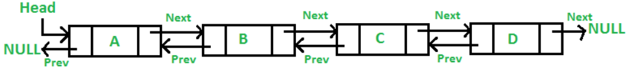
Doubly Linked List
Advantages of DLL over the singly linked list:
A DLL can be traversed in both forward and backward directions.
The delete operation in DLL is more efficient if a pointer to the node to be deleted is given.
We can quickly insert a new node before a given node.
In a singly linked list, to delete a node, a pointer to the previous node is needed. To get this previous node, sometimes the list is traversed. In DLL, we can get the previous node using the previous pointer.
Disadvantages of DLL over the singly linked list:
Every node of DLL Requires extra space for a previous pointer. It is possible to implement DLL with a single pointer though All operations require an extra pointer previous to be maintained. For example, in insertion, we need to modify previous pointers together with the next pointers. For example in the following functions for insertions at different positions, we need 1 or 2 extra steps to set the previous pointer.
A Doubly Linked List (DLL) contains an extra pointer, typically called the previous pointer, together with the next pointer and data which are there in the singly linked list.
struct Node // Node of a doubly linked list
{
int data;
struct Node* next; // Pointer to next node in DLL
struct Node* prev; // Pointer to the previous node in DLL
};

Slide 54
struct Node
{
int data;
struct Node* next;
struct Node* prev;
};
/* Given a reference (pointer to pointer) to the head of a
list and an int, inserts a new node on the front of the
list. */
void push(struct Node** head_ref, int new_data)
{
/* 1. allocate node */
struct Node* new_node
= (struct Node*)malloc(sizeof(struct Node));
/* 2. put in the data */
new_node->data = new_data;
/* 3. Make next of new node as head and previous as NULL
*/
new_node->next = (*head_ref);
new_node->prev = NULL;
/* 4. change prev of head node to new node */
if ((*head_ref) != NULL)
(*head_ref)->prev = new_node;
/* 5. move the head to point to the new node */
(*head_ref) = new_node;
}
/* Given a node as prev_node, insert a new node after the
* given node */
void insertAfter(struct Node* prev_node, int new_data)
{
/*1. check if the given prev_node is NULL */
if (prev_node == NULL) {
printf("the given previous node cannot be NULL");
return;
}
/* 2. allocate new node */
struct Node* new_node
= (struct Node*)malloc(sizeof(struct Node));
/* 3. put in the data */
new_node->data = new_data;
/* 4. Make next of new node as next of prev_node */
new_node->next = prev_node->next;
/* 5. Make the next of prev_node as new_node */
prev_node->next = new_node;
/* 6. Make prev_node as previous of new_node */
new_node->prev = prev_node;
/* 7. Change previous of new_node's next node */
if (new_node->next != NULL)
new_node->next->prev = new_node;
}
/* Given a reference (pointer to pointer) to the head
of a DLL and an int, appends a new node at the end */
void append(struct Node** head_ref, int new_data)
{
/* 1. allocate node */
struct Node* new_node
= (struct Node*)malloc(sizeof(struct Node));
struct Node* last = *head_ref; /* used in step 5*/
/* 2. put in the data */
new_node->data = new_data;
/* 3. This new node is going to be the last node, so
make next of it as NULL*/
new_node->next = NULL;
/* 4. If the Linked List is empty, then make the new
node as head */
if (*head_ref == NULL) {
new_node->prev = NULL;
*head_ref = new_node;
return;
}
/* 5. Else traverse till the last node */
while (last->next != NULL)
last = last->next;
/* 6. Change the next of last node */
last->next = new_node;
/* 7. Make last node as previous of new node */
new_node->prev = last;
return;
}
// This function prints contents of linked list starting
// from the given node
void printList(struct Node* node)
{
struct Node* last;
printf("\nTraversal in forward direction \n");
while (node != NULL) {
printf(" %d ", node->data);
last = node;
node = node->next;
}
printf("\nTraversal in reverse direction \n");
while (last != NULL) {
printf(" %d ", last->data);
last = last->prev;
}
}
// Driver code
int main()
{
/* Start with the empty list */
struct Node* head = NULL;
// Insert 6. So linked list becomes 6->NULL
append(&head, 6);
// Insert 7 at the beginning. So linked list becomes
// 7->6->NULL
push(&head, 7);
// Insert 1 at the beginning. So linked list becomes
// 1->7->6->NULL
push(&head, 1);
// Insert 4 at the end. So linked list becomes
// 1->7->6->4->NULL
append(&head, 4);
// Insert 8, after 7. So linked list becomes
// 1->7->8->6->4->NULL
insertAfter(head->next, 8);
printf("Created DLL is: ");
printList(head);
getchar();
return 0;
}

